Slide 1
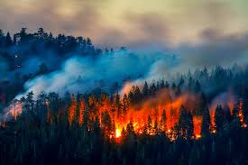
An Analysis of US Wildfires

Slide 2
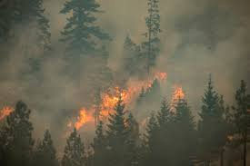
Wildfire Data
Data set included 1.88 million geo-referenced US wildfires that occurred in the United States from 1992 to 2015.
Records were acquired from the reporting systems of federal, state, and local fire organizations.
The database represents a total of 140 million acres burned during the 24 year period.
Data Citation: Short, Karen C. 2017. Spatial wildfire occurrence data for the United States, 1992-2015 [FPAFOD20170508]. 4th Edition. Fort Collins, CO: Forest Service Research Data Archive. https://doi.org/10.2737/RDS-2013-0009.4

Slide 3
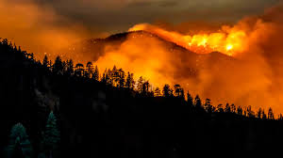
Key Variables
Latitude and Longitude of the fire’s point location
US State in which the fire occurred
Year the fire occurred
Discovery Date: date on which the fire was discovered or confirmed to exist
Containment Date: date on which the fire was declared contained or controlled
Cause of the fire
Size of the fire (in acres)
Owner of the fire: primary owner or entity responsible for managing the land at the point of origin of the fire (i.e., private vs federal/state land)

Slide 4
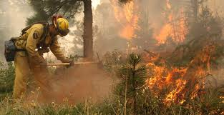
Data Preprocessing
Extraneous variables were eliminated (i.e., reporting agency, fire name, etc.)
Additional variables were calculated:
Duration of the fire (containment date – discovery date)
Month of the fire
Day of the week the fire occurred
Null values were removed for fire duration (a lot of missing values for containment date)
Categorical variables were dummy coded

Slide 5
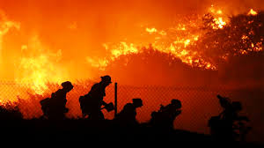
Analysis
Data visualizations were conducted using Tableau
Machine learning was performed to see if wildfires could be classified by how they were caused:
Nature (lightning)
Accidents - such as debris burning, campfires, equipment use, etc.
Intentional - arson

